Slide 1
Fraud Detection a machine learning model that predicts fraud transactions.

Slide 2
agenda
Introduction and Objectives
Dataset Analysis
Exploratory Data Analysis (EDA)
Model Development
Performance Evaluation
Financial Impact Analysis

Slide 3

This project starts by defining objectives and analyzing the dataset, followed by exploratory data analysis (EDA) to uncover patterns and insights. Predictive models are then developed and evaluated for accuracy and reliability. Finally, the financial impact of implementing these models is assessed to determine their value.

Slide 4

Dataset Analysis
Overview
The dataset contains 11,142 rows (transactions) and 10 columns (features).
Columns and Data Types
1. type: Type of transaction (e.g., TRANSFER, CASH_OUT) (categorical).
amount: Transaction amount (float).
nameOrig: Identifier for the source account (string).
oldbalanceOrg: Balance of the source account before the transaction (float).
newbalanceOrig: Balance of the source account after the transaction (float).
nameDest: Identifier for the destination account (string).
oldbalanceDest: Balance of the destination account before the transaction (float).
newbalanceDest: Balance of the destination account after the transaction (float).
isFraud: Fraud label (1 for fraud, 0 for legitimate) (integer).

Slide 5
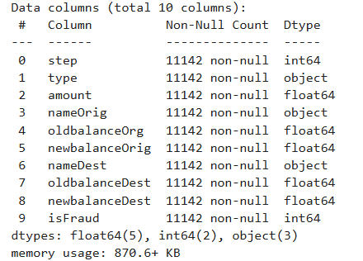
Exploratory Data Analysis (EDA):
There are no missing values
Out of 10 columns, 5 contain
float 2 integers and 3 objects
Approx 870 KB memory is used

Slide 6
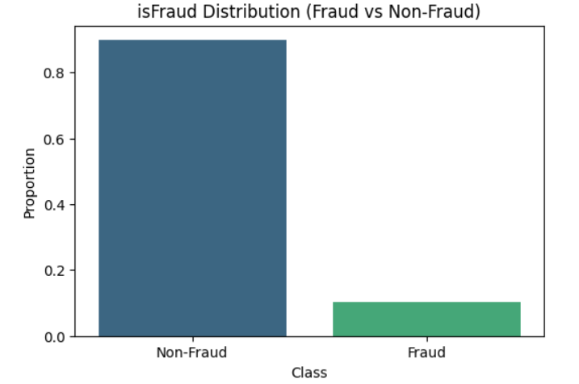
isFraud Distribution
In the isfraud column the
percentage of fraud and
non-feaud data
X-axis:- Class
Y-axis:- Proportion
Almost 89.75% of the data is
Non-Fraud
And 10.25% of the data is Fraud

Slide 7
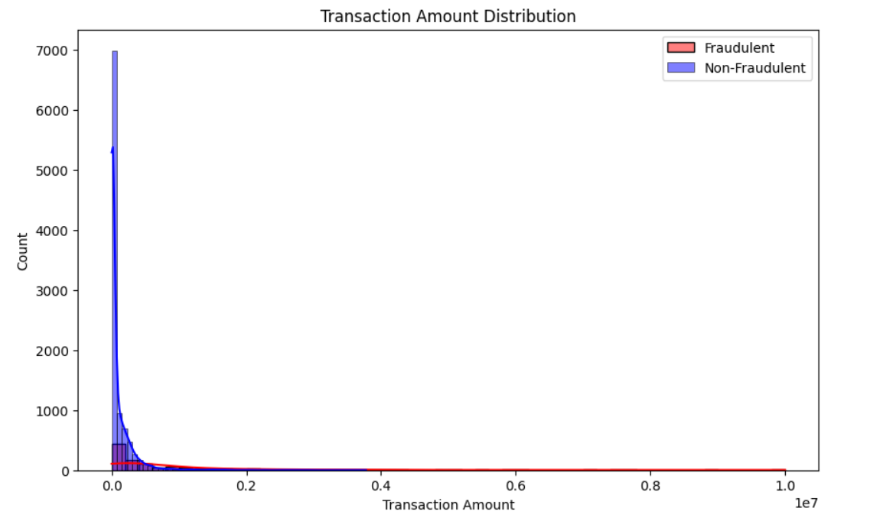
Transaction Amount Distribution
As you can see the fraud transaction
amount is less than the non-fraud
transaction amount
Approx 500 counts of fraud
transaction amount
And 7000 counts of non-fraud
transaction amount
As you can see kde line is getting
closed toward 0 which indicates fraud and
non-fraud transaction amount is decreasing

Slide 8
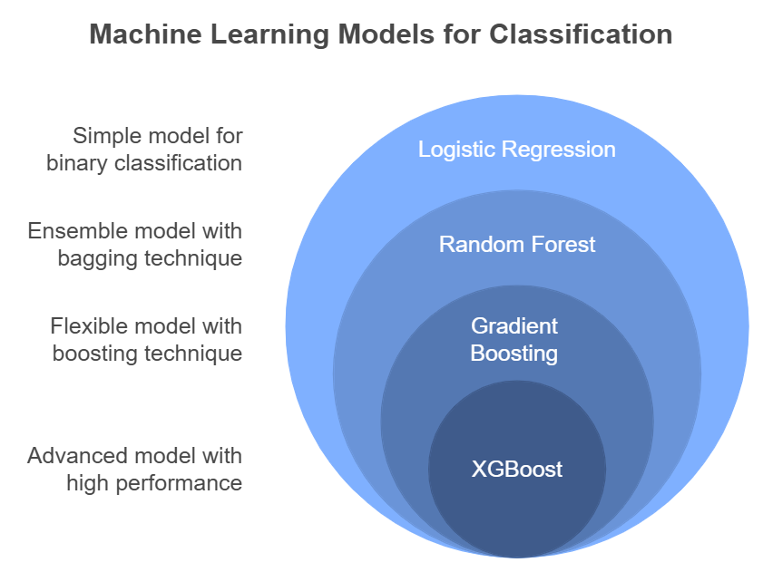
Model Development

Slide 9
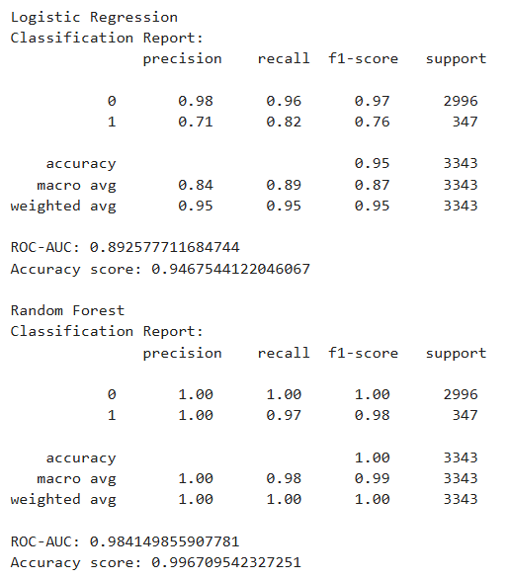
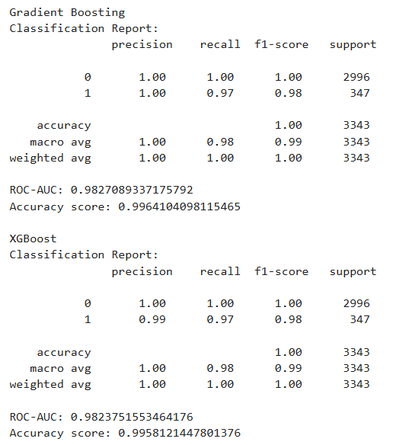
Model Performance
Classification Report:-

Slide 10
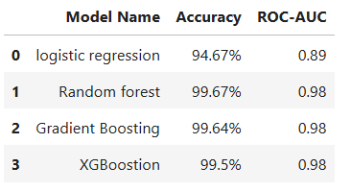
Important parameters of models

Slide 11
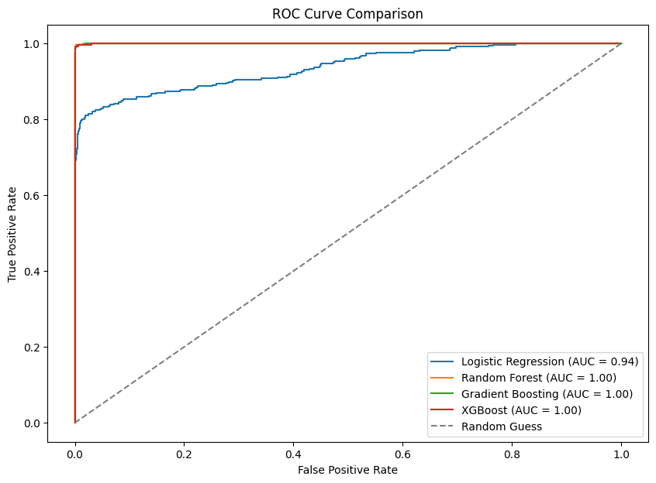
Comparsion of roc-curve
In this ROC curve we
See all models are
Towards True positive
Ratio, logistic regress-
-ion has less true positive
Rate compared to random
Forest gradient boosting
And XGBoosting, and
The dotted line are
Random guess

Slide 12
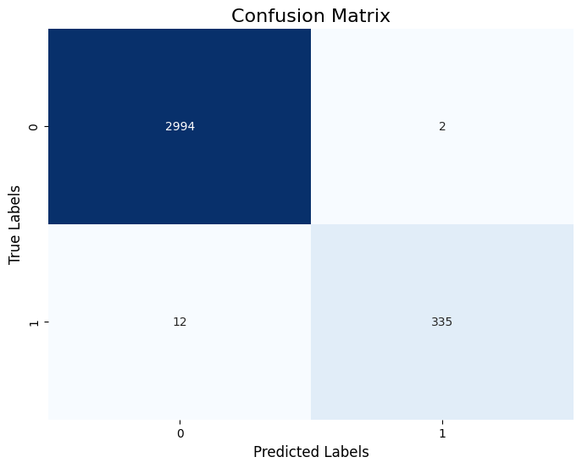
Confusion Matrix
The matrix consists of four sections:
Top-left (2994):
Represents the True Negatives (TN).
These are cases where the actual class is 0
and the model correctly predicted 0.
Top-right (2):
Represents the False Positives (FP).
These are cases where the actual class is 0,
but the model incorrectly predicted 1.
Bottom-left (12):
Represents the False Negatives (FN).
These are cases where the actual class is 1,
but the model incorrectly predicted 0.
Bottom-right (335):
Represents the True Positives (TP).
These are cases where the actual class is 1
and the model correctly predicted 1.

Slide 13
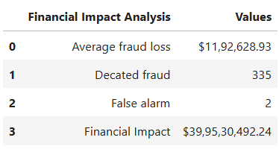
Financial Impact Analysis
Average fraud loss: The average loss caused by fraudulent transactions.
Detected fraud: The total number of fraudulent transactions correctly identified.
False alarm: The total number of non-fraud transactions wrongly flagged as fraud.
Financial impact: The net monetary effect of the model's fraud detection performance.

Slide 14
Thank you

